Slide 1
Family Background, Education And Economic Setup
Q3Juveniles family background, education and economic setup.
Query:-
SELECT c.Area_Name,c.Sub_Group_Name,
(sum(c.Economic_Set_up_Annual_Income_upto_Rs_25000)) as Income_upto_Rs_25000,
(sum(c.Economic_Set_up_Annual_Income_25001_to_50000)) as Income_25001_to_50000,
(sum(c.Economic_Set_up_Middle_income_from_50001_to_100000)) as income_from_50001_to_100000,
(sum(c.Economic_Set_up_Middle_income_from_100001_to_200000)) as income_from_100001_to_200000,
(sum(c.Economic_Set_up_Upper_middle_income_from_200001_to_300000)) as income_from_200001_to_300000,
(sum(c.Economic_Set_up_Upper_income_above_Rs_300000)) as income_above_Rs_300000,
b.Sub_Group_Name,
(sum(b.Family_back_ground_Homeless )) as Homeless ,
(sum(b.Family_back_ground_Living_with_guardian )) as Living_with_guardian,
(sum(b.Family_back_ground_Living_with_parents)) as Living_with_parents,
a.Sub_Group_Name,

Slide 2
(sum(a.Education_Illiterate )) as Illiterate,
(sum(a.Education_Upto_primary)) as Upto_primary,
(sum(a.Education_Above_Primary_but_below_Matric_or_Higher_Secondary)) as Below_Matric,
(sum(a.Education_Matric_or_Higher_Secondary_and_above)) as Above_Matric
FROM "18_02_Juveniles_arrested_Economic_setup" as c
INNER JOIN "18_03_Juveniles_arrested_Family_background" as b
on a.Area_Name=b.Area_Name
INNER JOIN "18_01_Juveniles_arrested_Education" as a
on c.Area_Name=a.Area_Name
GROUP by c.Area_Name;

Slide 3
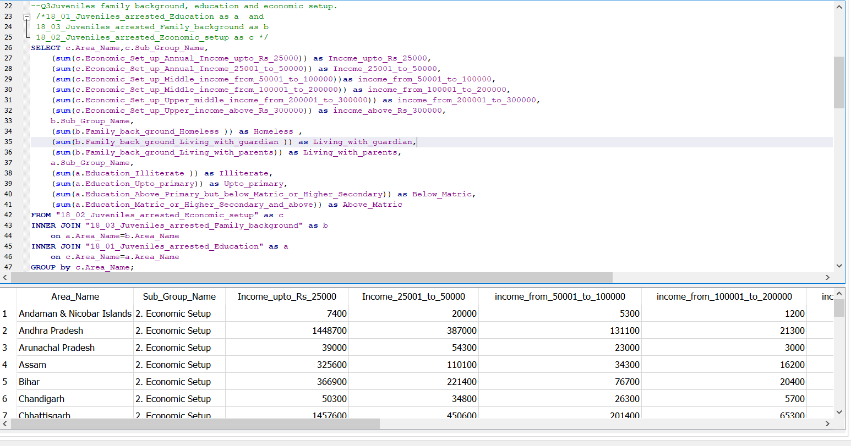
Our query screenshot:-

Slide 4
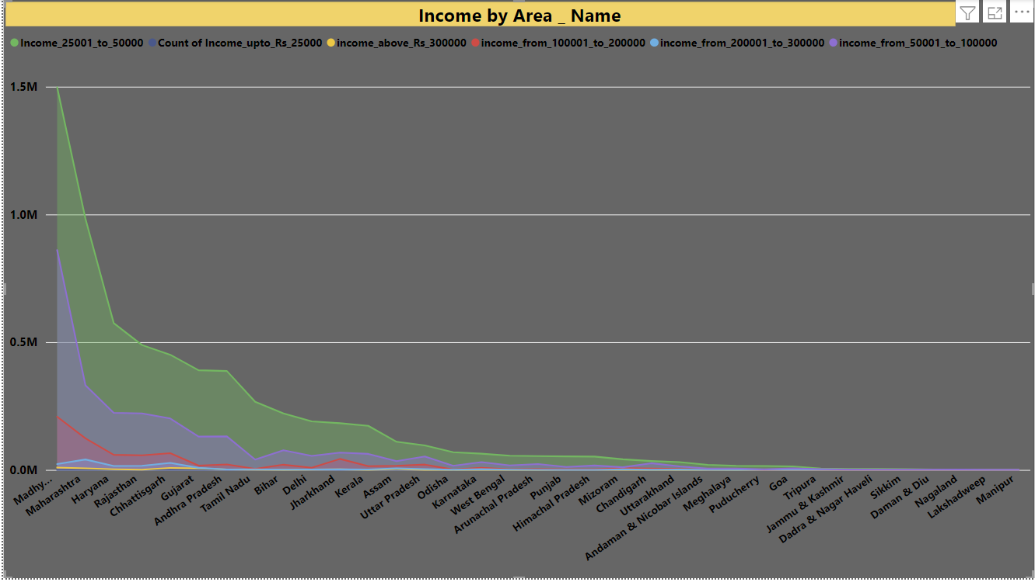
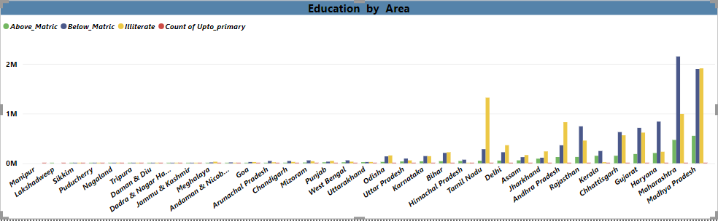
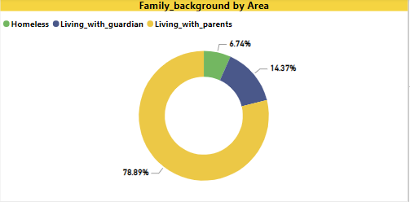
Conclusion:- 1. ﻿Madhya Pradesh had 1497900 Income_25001_to_50000, 1 Count of Income_upto_Rs_25000, and 9500 income_above_Rs_300000. 2. Across all 35 Area_Name, Illiterate ranged from 0 to 1913000, Count of Upto_primary ranged from 1 to 1, and Below_Matric ranged from 0 to 2151800.﻿

